Slide 1
Case Law Update
May 12, 2022
U.S. Sentencing Commission
Office of Education and Sentencing Practice
This presentation is produced and disseminated at U.S. taxpayer expense.

Slide 2
Learning Objectives
Your active engagement in this session will empower you to:
Describe recent Supreme Court decisions on sentencing;
Describe recent Eighth Circuit decisions on:
  §2B1.1;
  §3E1.1;
  sentencing procedure; and
  supervised release.

Slide 3
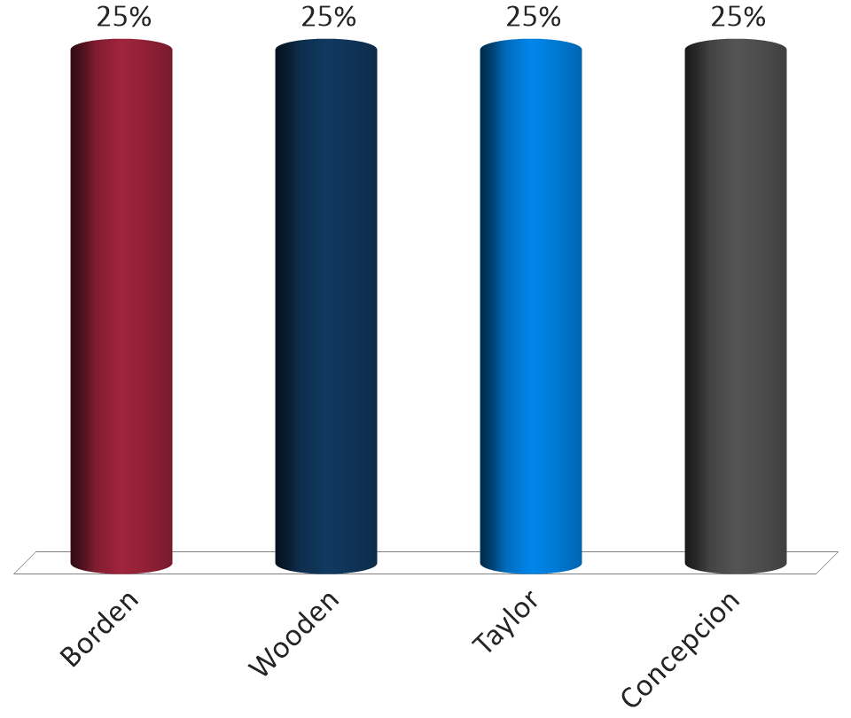
Which of the following cases were NOT heard during the October Term 2021?
Borden
Wooden
Taylor
Concepcion

Slide 4
Armed Career Criminal Act
18 U.S.C. § 924(e)
15-year mandatory minimum if:
  18 U.S.C. § 922(g);
  Three prior convictions for violent felonies, serious drug offenses, or both; AND
  The prior convictions were “committed on occasions different from one another.”

Slide 5
Wooden vs. United States
142 S. Ct. 1063 (2022)
Mr. Wooden, in a single evening, burglarized ten units in a single storage facility.
Mr. Wooden proceeded unit to unit by crushing the drywall.
For this conduct, Mr. Wooden received 10 prior burglary convictions.

Slide 6
Wooden vs. United States
142 S. Ct. 1063 (2022)
Mr. Wooden is later found guilty of felon in possession in federal court.
Do Mr. Wooden’s ten burglaries count as a single violent felony or ten violent felonies?

Slide 7
Wooden vs. United States
142 S. Ct. 1063 (2022)
Offenses arising from a single criminal episode do not occur on different occasions.

Slide 8
3 Factors to Examine
Character & relationship of offenses
Timing of offenses
Proximity of location

Slide 9
United States v. Taylor
Docket No. 20-1459
Question presented:
  Whether 18 U.S.C. § 924(c)(3)(A)’s definition of “crime of violence” excludes attempted Hobbs Act robbery, in violation of 18 U.S.C. § 1951(a).

Slide 10
Concepcion v. United States
Docket No. 20-1650
Question presented:
  Whether, when deciding if it should “impose a reduced sentence” on an individual under Section 404(b) of the First Step Act of 2018, a district court must or may consider intervening legal and factual developments.

Slide 11
Economic Offenses

Slide 12
Credits Against Loss
App. Note 3(E) (p. 91)
Loss shall be reduced by:
  Certain benefits transferred (before detection)
  Collateral pledged (value at time of sentencing)

Slide 13
United States v. Luna
968 F.3d 922 (8th Cir. 2020)
In a case about a recruitment-and-kickback scheme involving car-accident victims, a chiropractic clinic, and automobile insurers, §2B1.1 loss does not include the legitimate, compensable services provided by the chiropractic clinic.

Slide 14
Acceptance of Responsibility

Slide 15
Acceptance of Responsibility
§3E1.1(a)
If the defendant clearly demonstrates acceptance of responsibility for his offense, decrease the offense level by 2 levels.

Slide 16
What factors should a court consider in granting acceptance?
Truthful Admissions
Timeliness of Acceptance
Not Falsely Denying Relevant Conduct
§3E1.1, App. Note 1
Post-Offense Rehabilitation
Terminating Criminal Conduct
Voluntary Resignation
Voluntary Restitution
Voluntary Surrender

Slide 17
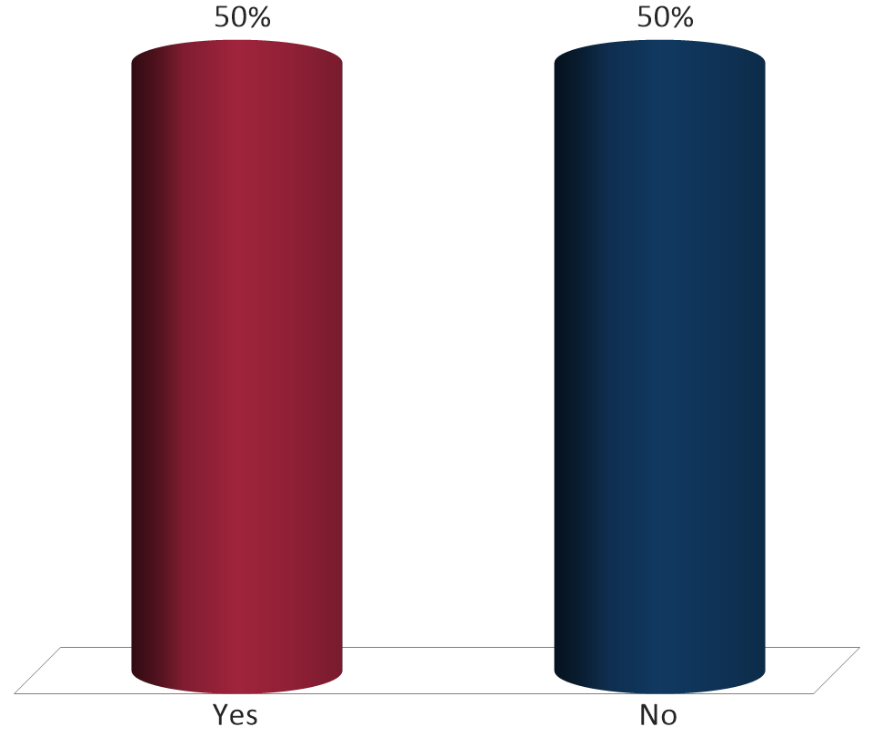
The defendant pleaded guilty only to possession of child pornography (CP). The evidence, however, proved that the defendant distributed CP. Is the defendant entitled to acceptance of responsibility if, at sentencing, he affirmatively denies distributing CP?
Is the defendant entitled to acceptance?
Yes
No

Slide 18
United States v. Hennings
23 F.4th 820 (8th Cir. 2022)
The court did not err when it denied acceptance of responsibility where the defendant made frivolous factual objections, claimed that he did not possess or distribute child pornography, and denied sexual conduct that he had previously admitted.

Slide 19
United States v. Cooper
998 F.3d 806 (8th Cir. 2021)
A court may deny a 2-level reduction for acceptance under §3E1.1(a) based on a defendant’s pre-plea criminal conduct.

Slide 20
Imagine the government agrees to seek acceptance in the plea agreement. Can the government use evidence of pre-plea misconduct to deny acceptance?
Yes
No

Slide 21
United States v. Collins
25 F.4th 1097 (8th Cir. 2022)
The government breached the plea agreement, in which it agreed to recommend a §3E1.1 adjustment, by using the defendant’s pre-plea conduct to challenge acceptance.
The government’s breach is not subject to harmless error review, and the government’s breach here was not cured when the court applied the same guidelines range as the plea agreement.

Slide 22
United States v. Brown
5 F.4th 913 (8th Cir. 2021).
The government breaches a plea agreement by arguing for a higher offense level than that specified in the plea agreement.
Even if the government could cure this type of breach, here, “its halfhearted and begrudging statement that the district court should follow the agreement was not enough.”

Slide 23
Supervised Release

Slide 24
Mandatory, Standard, & Special Conditions
Mandatory Conditions are statutorily required.
  18 U.S.C. § 3583 and §5D1.3(a)
Standard Conditions are recommended in all cases.
  §5D1.3(c)
Special Conditions are recommended in some cases and circumstances.
  §5D1.3(d)

Slide 25
Requirements for Imposing Discretionary Conditions
Reasonably related to:
  Offense/defendant; and
  Specific and general deterrence and rehabilitation.
No greater deprivation of liberty than reasonably necessary.

Slide 26
United States v. Sterling
959 F.3d 855 (8th Cir. 2020)
A condition of supervised release that required the defendant to disclose “any” financial information requested by the probation office, including unexpected financial gains, was vague and overbroad.

Slide 27
Revocation of Supervised Release
18 U.S.C. § 3583(e)(3)
The court may, after considering the factors set forth in § 3553(a)(1), (a)(2)(B), (a)(2)(C), (a)(2)(D), (a)(4), (a)(5), (a)(6), and (a)(7) . . . revoke a term of supervised release.
The statute does not reference “seriousness of the offense, to promote respect for the law, and to provide just punishment.”

Slide 28
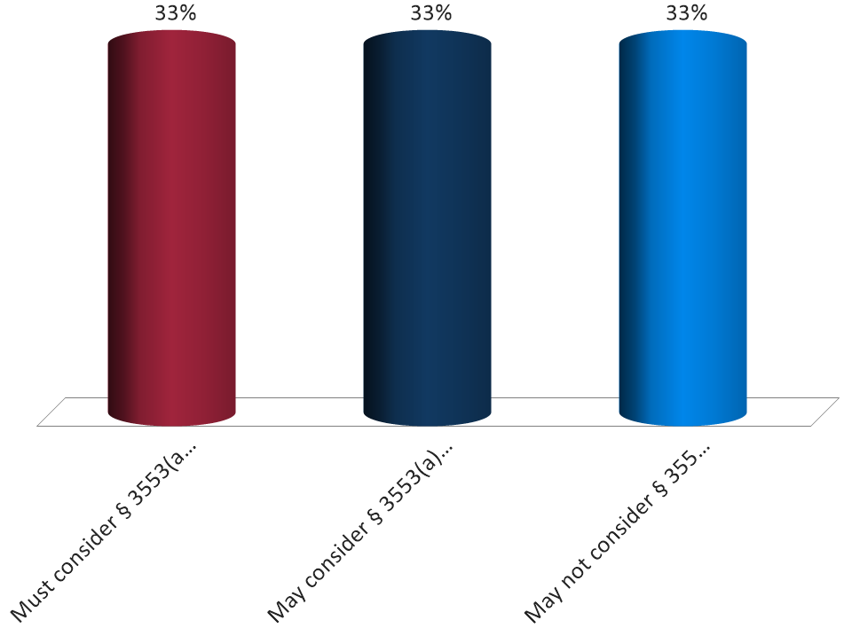
In determining whether the revoke a defendant’s supervise release and impose a term of imprisonment, a court . . .
Must consider § 3553(a)(2)(A)
May consider § 3553(a)(2)(A)
May not consider § 3553(a)(2)(A)

Slide 29
United States v. Porter
974 F.3d 905 (8th Cir. 2020)
The court did not give undue weight to an impermissible sentencing factor, that is, respect for the law, in revoking the defendant’s supervised release.

Slide 30
Learning Outcomes
You should now be able to:
Describe recent Supreme Court decisions on sentencing;
Describe recent Eighth Circuit decisions on:
  §2B1.1;
  §3E1.1;
  sentencing procedure; and
  supervised release.

